Slide 1
Database Project: Lebanese Railways
Instructor: Mario Maroun
Done by: Hadi Dayeh, Mahmoud Farhat

Slide 2
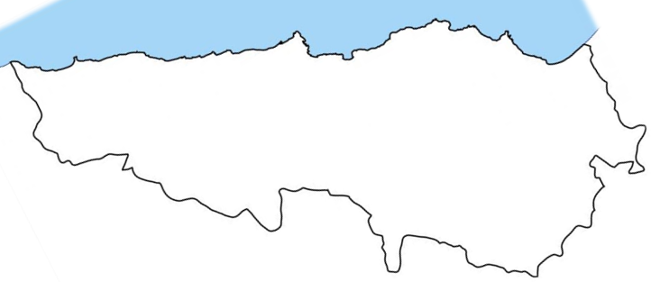
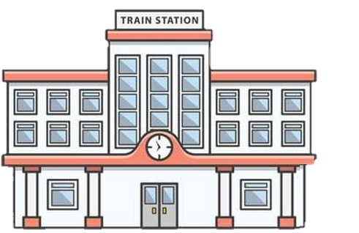
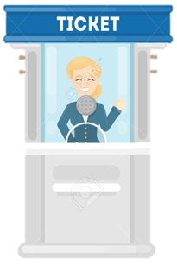









Sour
Beirut
Tripoli




Slide 3
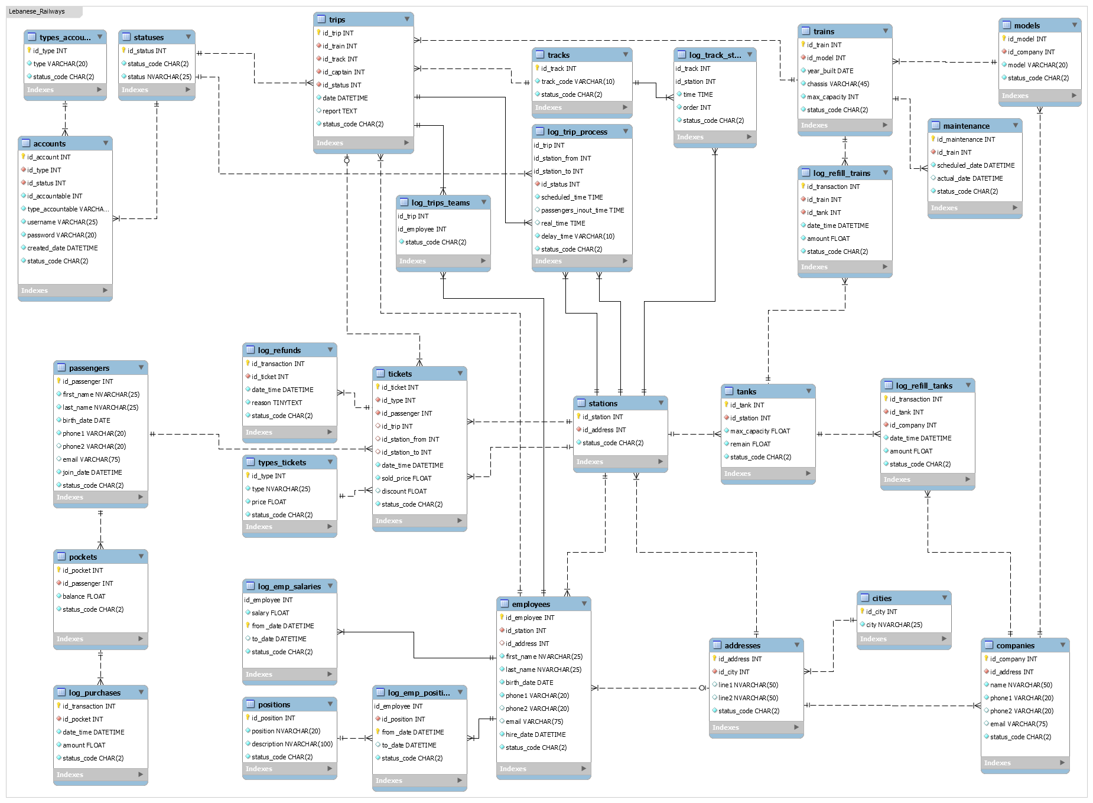

10- "trips" are run under a schedule.
09- A "passenger" joins "trips" from a station to another.
08- "Tickets" could be refunded for a reasons or another.
07- Each "purchase transaction" should be stored.
06- A "passenger" buys a ticket.
05- "Employees", "stations", and "companies", each has an "address".
04- Each "station" has many tanks, and each "tank" belongs to one station.
03- Each "train" has a "model" and is made by a company.
02- Each "ticket" has a "type" which could belong to another ticket too.
01- Each "passenger" has a "pocket".

Slide 4
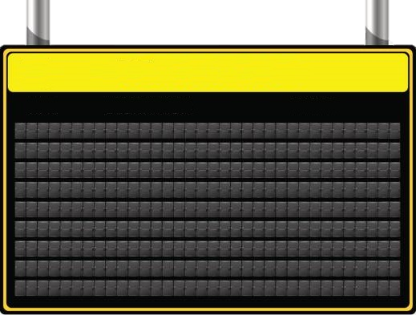
Schedule From Monday to Friday
Station Time
Sour 11:30 12:00 12:30 13:00 13:30 14:00 14:30 15:00 15:30 16:00 16:30
Beirut 12:00 12:30 13:00 13:30 14:00 14:30 15:00 15:30 16:00 16:30 17:00
Tripoli 12:30 13:00 13:30 14:00 14:30 15:00 15:30 16:00 16:30 17:00 17:30
Track 12 ..................................................................................................................................... Track 22
Sour 06:00 06:30 07:00 07:30 08:00 08:30 09:00 09:30 10:00 10:30 11:00
Beirut 06:30 07:00 07:30 08:00 08:30 09:00 09:30 10:00 10:30 11:00 11:30
Tripoli 07:00 07:30 08:00 08:30 09:00 09:30 10:00 10:30 11:00 11:30 12:00
Track 1 ....................................................................................................................................... Track 11

Slide 5
18- "Employees" and "passengers", each has an "account" on the system.
17- Each "employee" works at a station.
16- Each "employee" has a "position" and a salary that could change, but the change history should be saved.
15- The tanks are also refilled repeatedly by outside companies.
14- All "trains" are refilled with fuel several times per day, and each refill transaction should be saved.
13- All "trains" have to be checked up in a schedule.
12- Each "trip" is run by a team of "employees“, one of them is the captain, using a train.
11- A "trip" has a status. It could be on time, canceled, delayed, etc...
10- "trips" are run under a schedule.

Slide 6
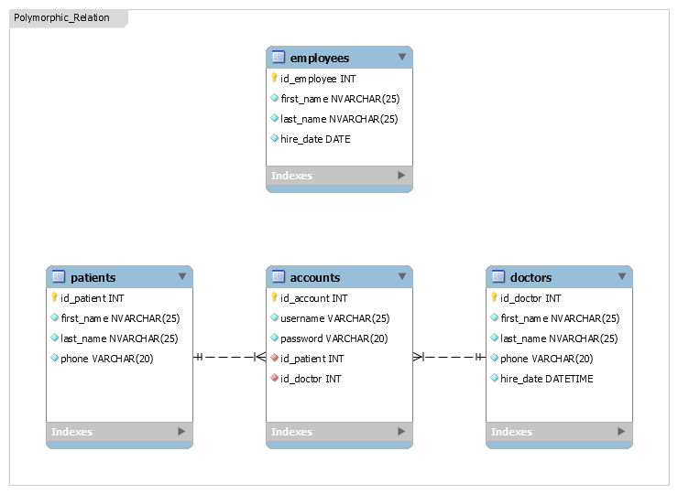
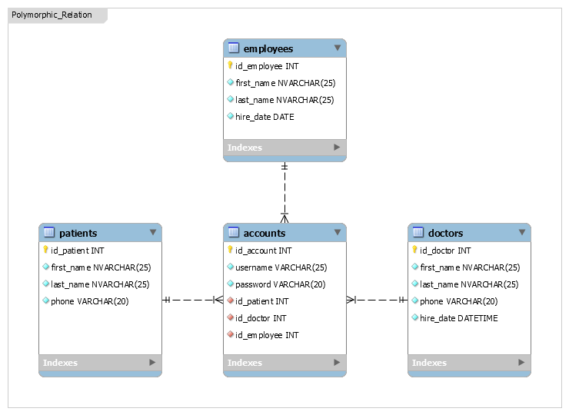
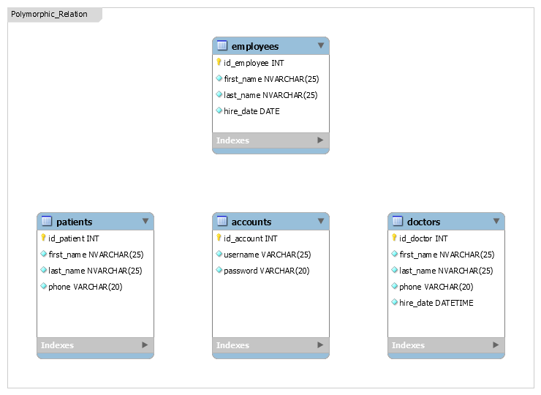

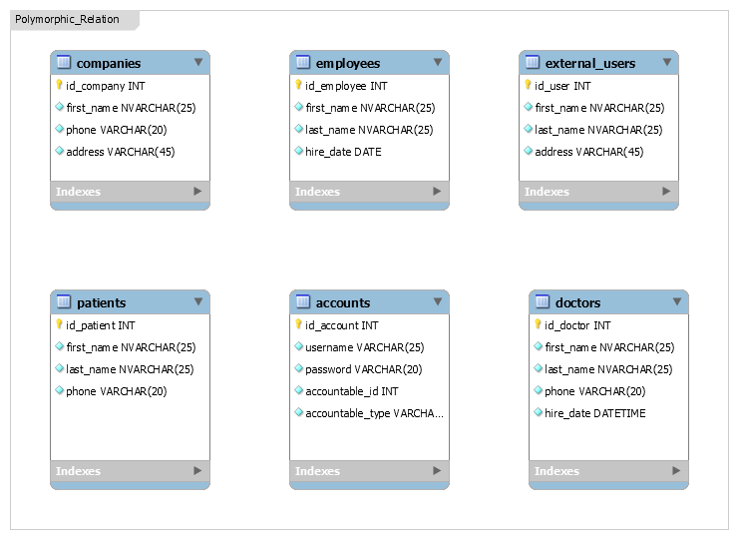

Polymorphic Relationship:
A polymorphic relationship is where an entity can belong to more than one other entity on a single association.

Slide 7
20- "Accounts" could be deactivated and reactivated.
18- "Employees" and "passengers", each has an "account" on the system.
19- Users could be "external", "internal", "financial", "admin", etc...

Slide 8
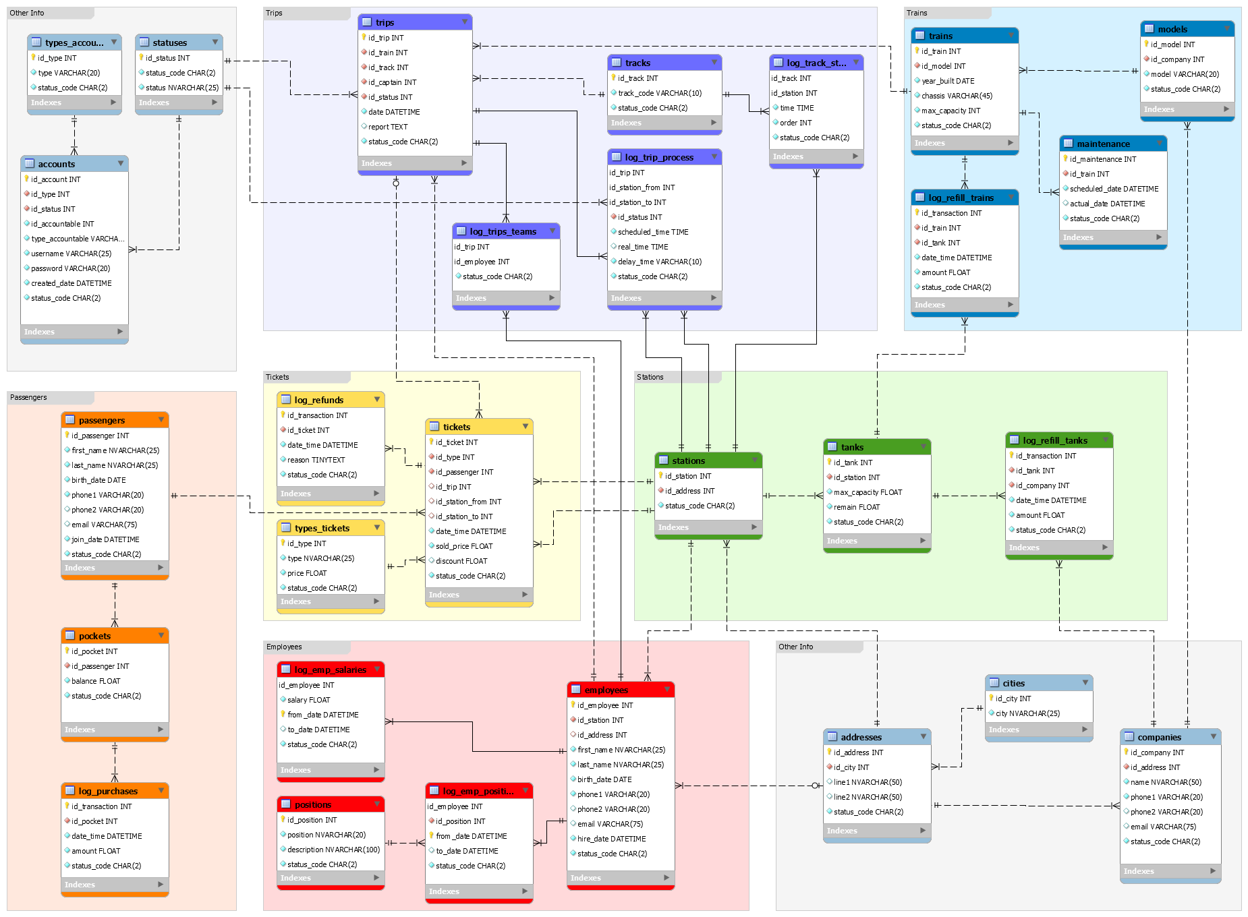

Slide 9
Why MySQL ??
It’s free (much cheaper than oracle).
Open source.
Cross platform compatibility.
Many of the world's largest and fastest-growing organizations including Facebook, Google, Adobe and Alcatel Lucent rely on MySQL to save time and money powering their high-volume Web sites, business-critical systems and packaged software.

Slide 10
What is MySQL ??
MySQL is an Oracle-backed open source relational database management system (RDBMS) based on Structured Query Language (SQL). MySQL runs on virtually all platforms, including Linux, UNIX and Windows. Although it can be used in a wide range of applications, MySQL is most often associated with web applications and online publishing.

Slide 11
